Slide 1
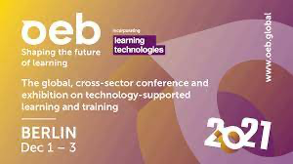
The New Normal is about Resilience, Sustainability, and the Social Contract
Prof. Dr. Ebba Ossiannilsson, Sweden
OEB21 Shaping the Future of Learning
Diverse. Collaborative. Transformative
2nd December 2021

Slide 2
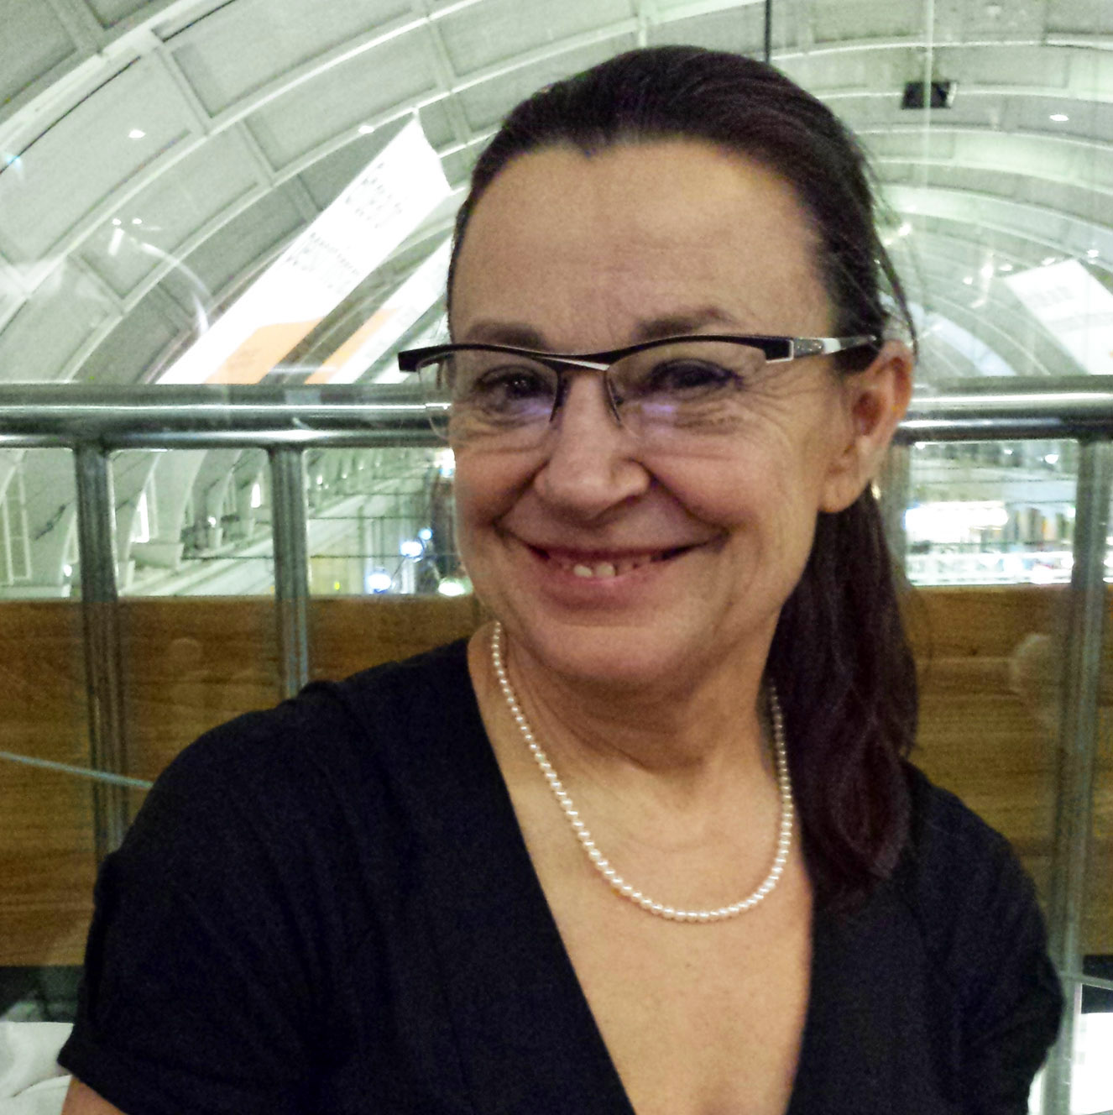
Professor, Dr. Ossiannilsson, Sweden
... is an independent consultant, expert, influencer and quality reviewer in the field of open, flexible, online and distance learning. She advocates for the promotion and improvement of open and online learning in the context of SDG4 and the future of education. She is a member of the Executive Committee of ICDE and EDEN. She works as an international quality reviewer for EADTU and ICDE. Ossiannilsson is chair of the ICDE OER Advocacy Committee. She also has several other roles for ICDE, such as ICDE Quality Network, and she was a research leader for the Global Overview of Quality Models Study 2014/15 and for Blended Learning 2017. Ossiannilsson was awarded the title of EDEN Fellow 2014, EDEN Council of Fellows 2018, Open Education Europa Fellow 2015, ICDE Global Advocacy Ambassador for OER 2017, and Open Education Champion SPARC Europe , 2021. Ossiannilsson has almost 20 years of experience in her field. Ossiannilsson also works with the European Commission and ITCILO. She collaborates with ICoBC (International Council on Badges and Credentials). She is a member of the editorial board of several scientific journals and is regularly invited as a keynote speaker at conferences. Her publications include more than 200. At the national level, she is Vice President of the Swedish Association for Distance Education (SADE) and the National Organization for e-Competence (REK).

Slide 3
ABSTRACT OEB GLOBAL 2021
This session will take the stand in current global initiatives on the futures of education in the context of social justice and human rights. There is an urgency for a change of course in education and in the way we look at learning for all, especially at a time of profound crises in health, governance, economics and the environment - and to show how education can be regenerative. At this moment of historic transition, there is an urgent need for education to be able to value the public and shared dimensions of the world and to strengthen the ways in which we learn together. Despite great efforts, our current education strategies have failed to ensure equal educational opportunities for all. They are even less able to meet the new challenges. Education must be redefined as a public good and a collective global responsibility, with education as a human right as its central axis. Only such a radical reorientation can strengthen our common humanity and ensure sustainable relationships with others, nature and technology. We cannot simply carry on as before if we are to confront ecological and technological disruption and reach 2050 with a world in which people live well with each other and with the planet. The overview given at the session can be taken as an example of what major international organizations are advocating and initiating in terms of the futures, especially building an ecosystem that includes resilience in education, social justice, human rights and sustainability. New questions have emerged in all countries, such as the following. - Are our education systems preparing students for a world driven by disruptive scientific and technological advances in artificial intelligence, robotics, biotechnology, clean energy, and quantum computing? - Are we encouraging students to think critically about how science, technology, and innovation can help address-or exacerbate-economic, geopolitical, environmental, and societal challenges? Those identified challenges requires as well an redefined quality agenda and ti identify stakeholders involved and in charge.

Slide 4
The next normal ”s”, building forward differently - for wellbeing, empathy and the social contract
The pandemic COVID -19 exposed vulnerabilities; but it also revealed extraordinary human capabilities and potentials.
Decisions made today will have long-term consequences for the futures of education. Decisions must be based on a humanistic vision of education, development, resilience, and human rights.
The pandemic has changed the way we think about our education, our economy and our society. COVID-19 has the potential to radically transform our world. Now is the time for public deliberation and democratic accountability. Now is the time for intelligent collective action. The choices we make today will determine our success in transitioning to a greener, more inclusive and resilient future. It is an opportunity to chart a path that empowers everyone to face the futures with confidence.
The session will focus on the lesson learned from the pandemic which is that the next normal in education and learning must be built forward and differently to achieve well-being and empathy for individuals and for society.

Slide 5
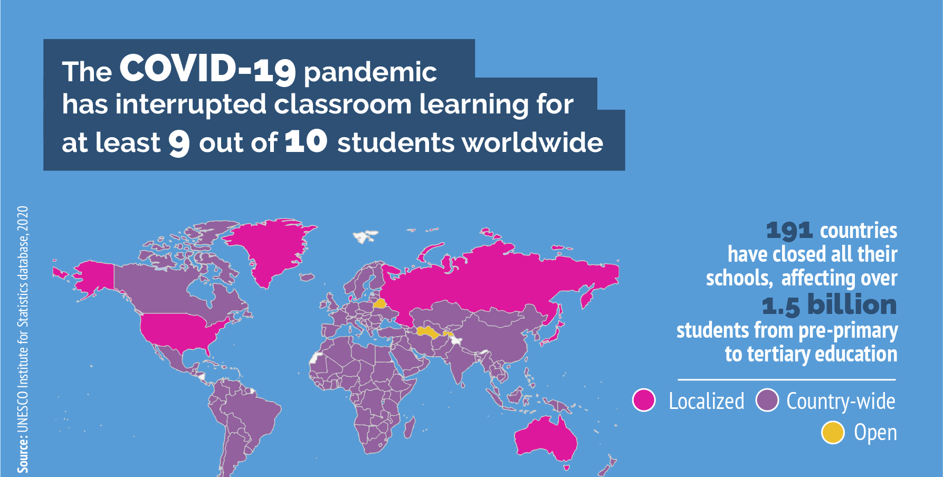

Slide 6

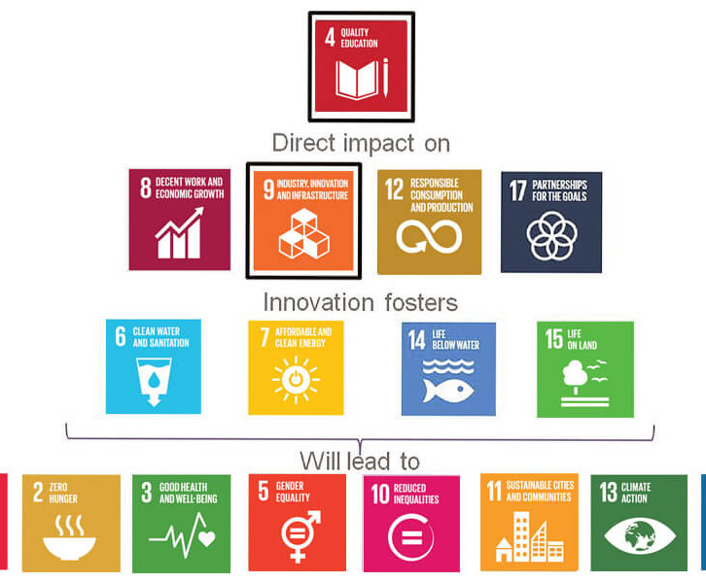
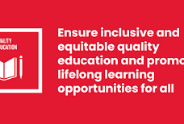

Slide 7
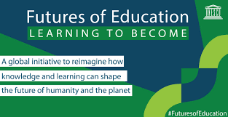

Slide 8
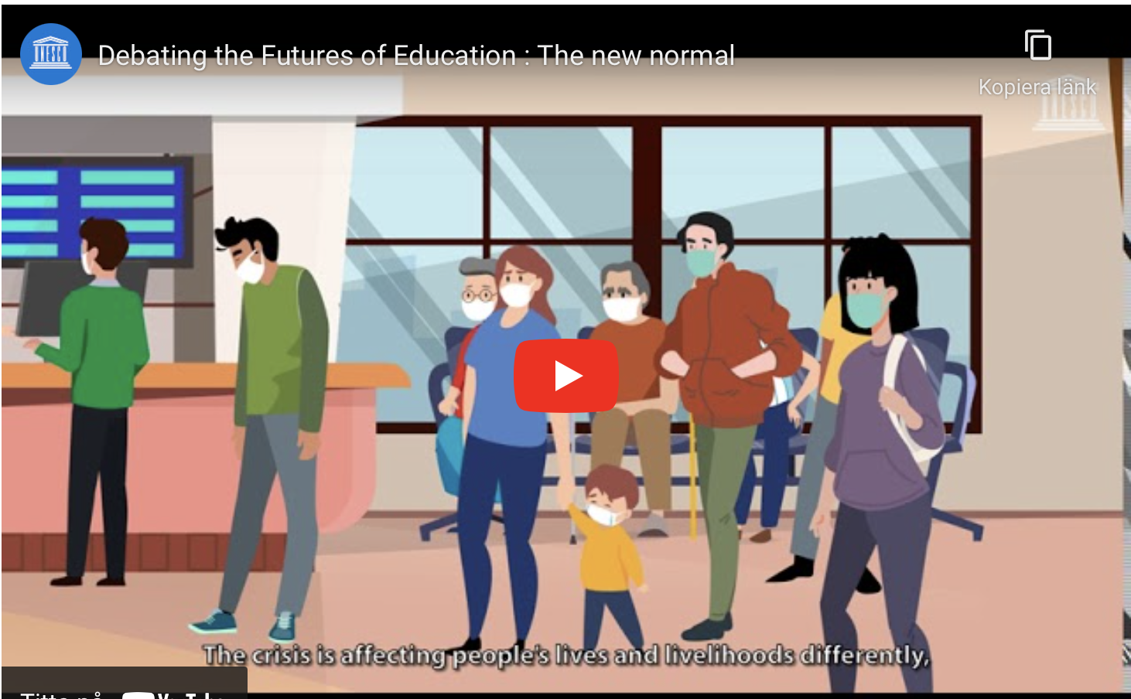

Slide 9
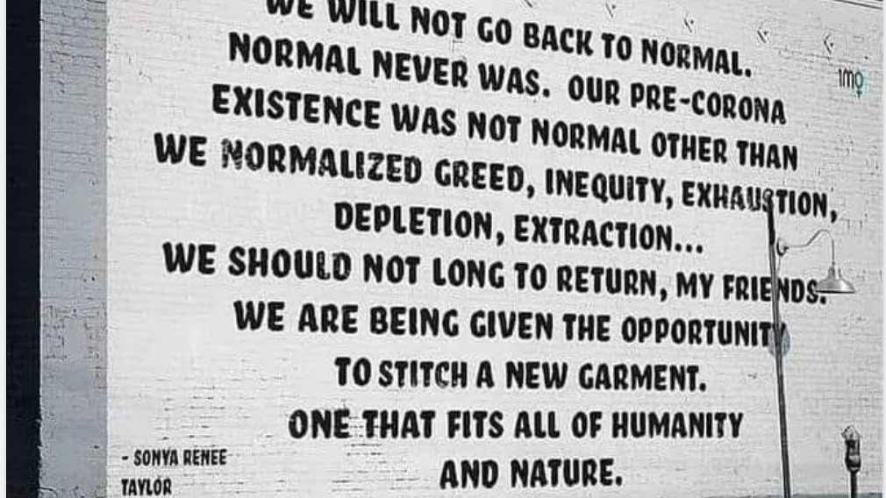

Slide 10
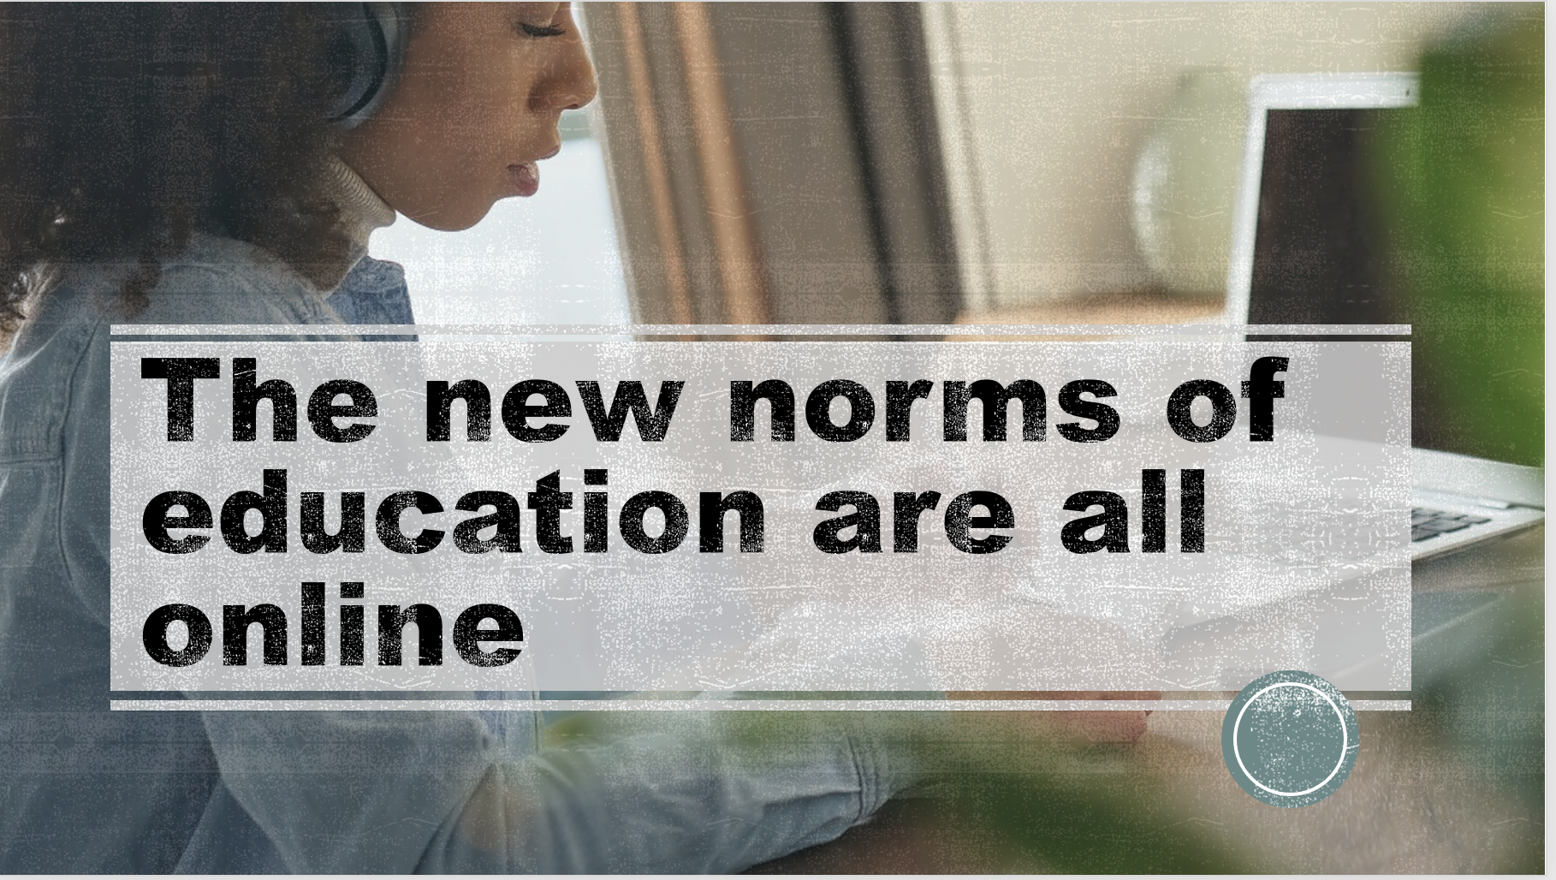

Slide 11
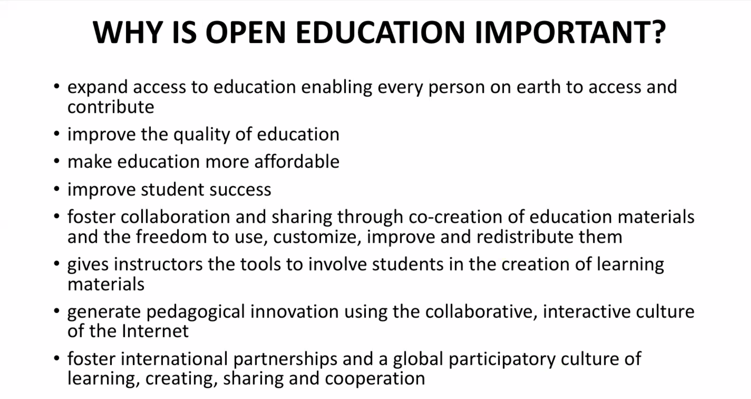

Slide 12
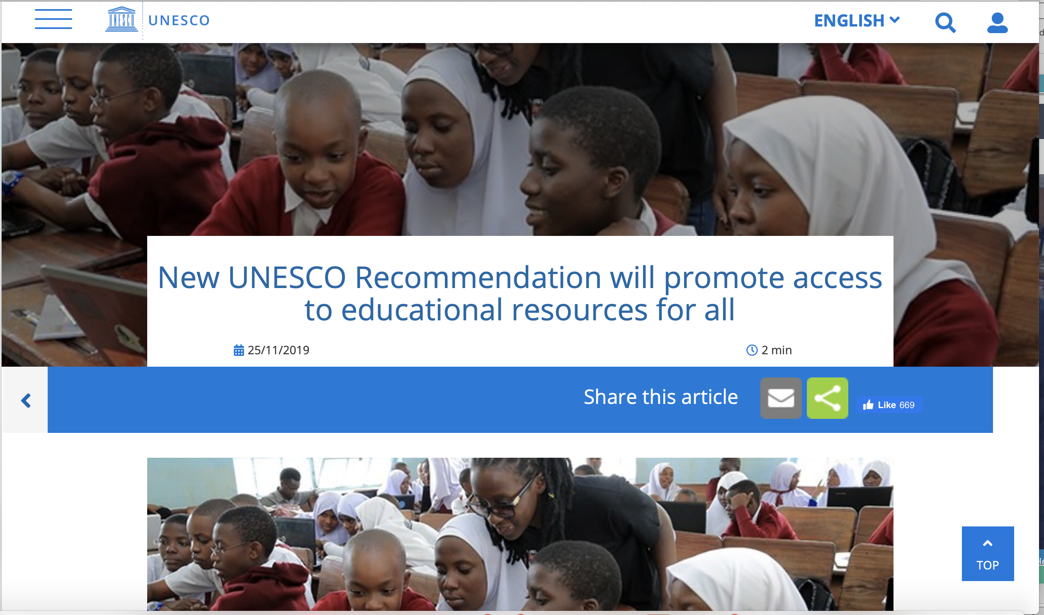

Slide 13

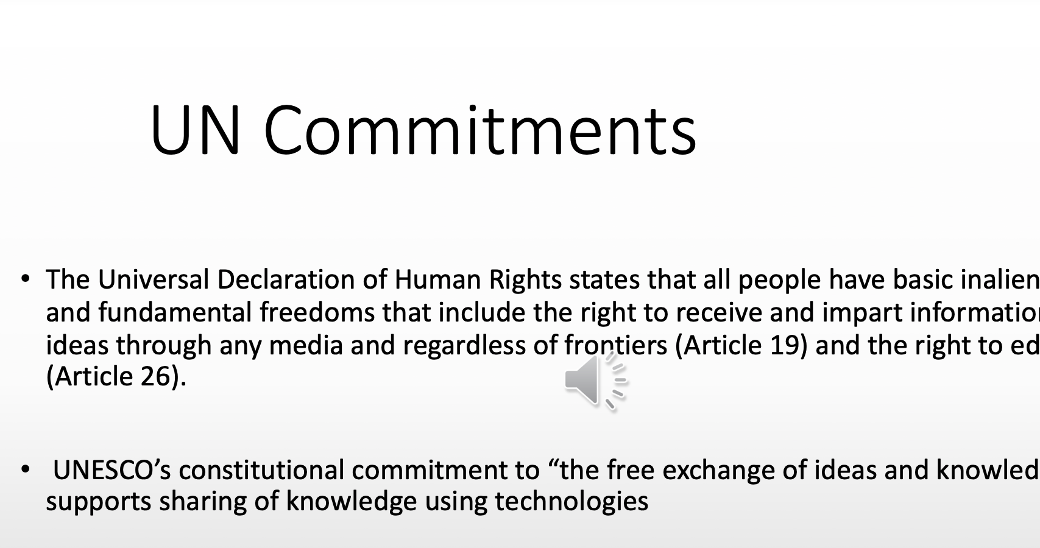

Slide 14

Recommendation on Open Educational Resources (OER)
Building
Building capacity of stakeholders to create, access, re-use, adapt and redistribute OER
Developing
Developing supportive policy
Encouraging
Encouraging effective, inclusive and equitable access to quality OER
Nurturing
Nurturing the creation of sustainability models for OER
Promoting and reinforcing
Promoting and reinforcing international cooperation
+ MONITORING AND EVALUATION

Slide 15
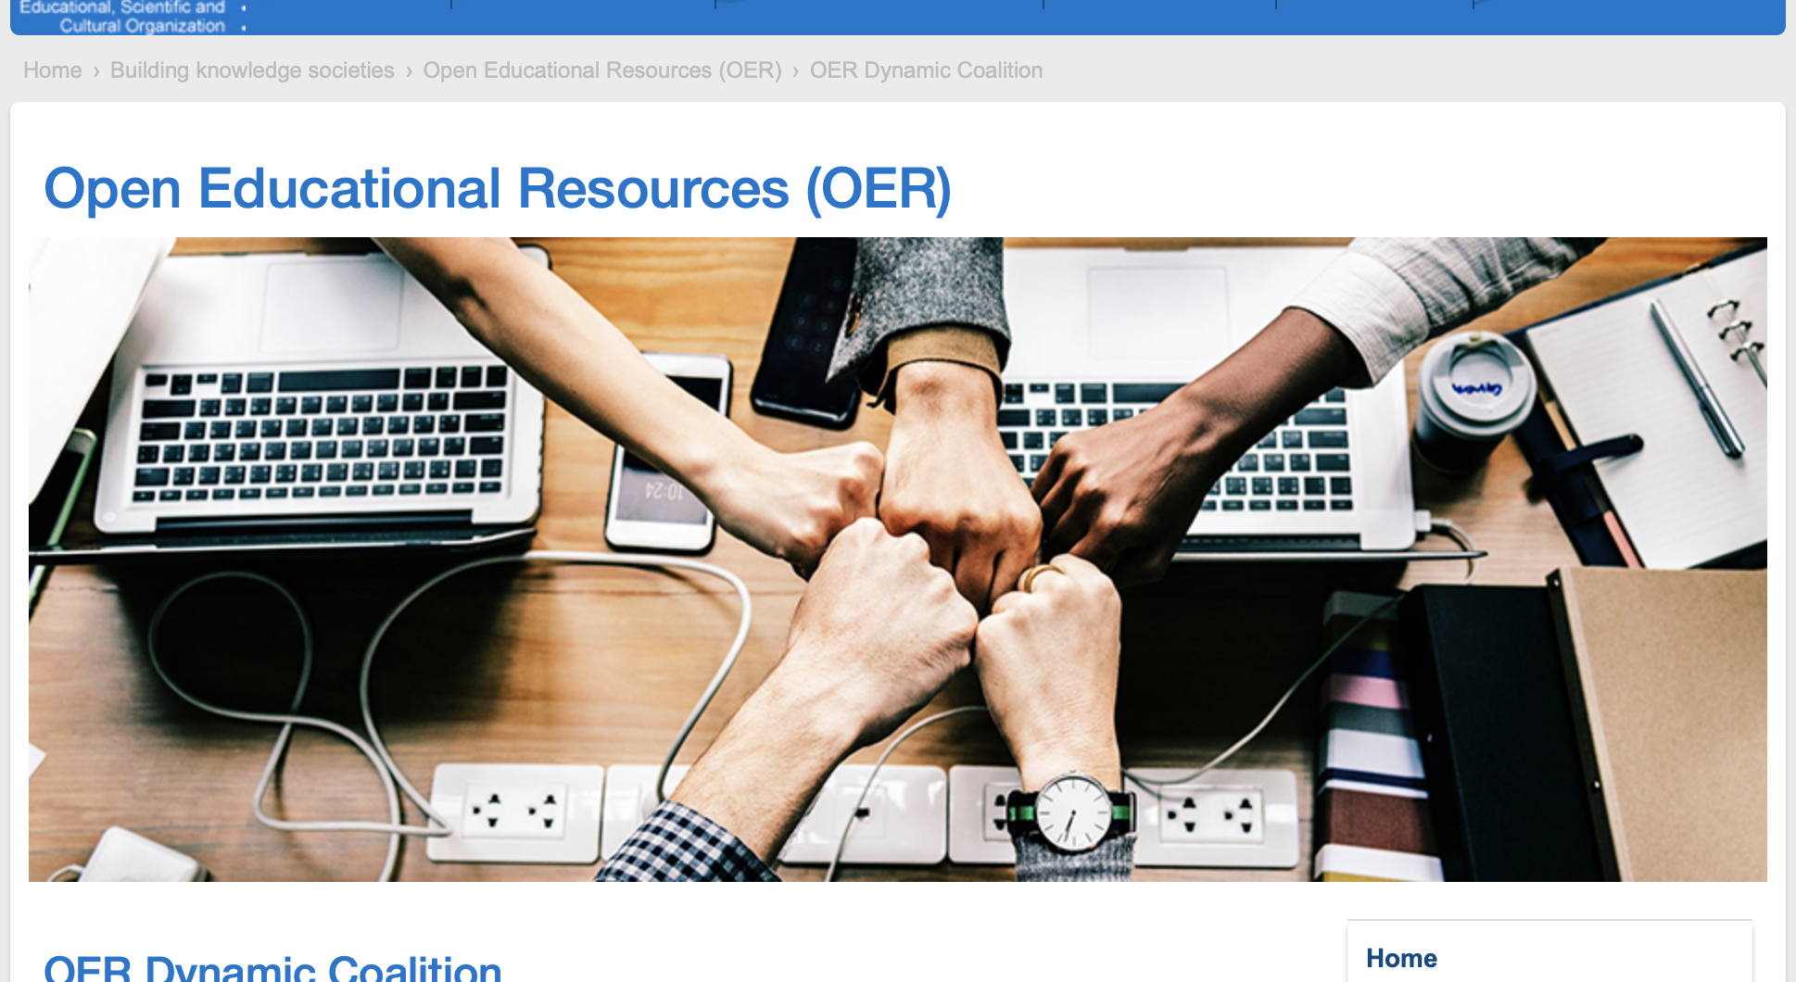

Slide 16
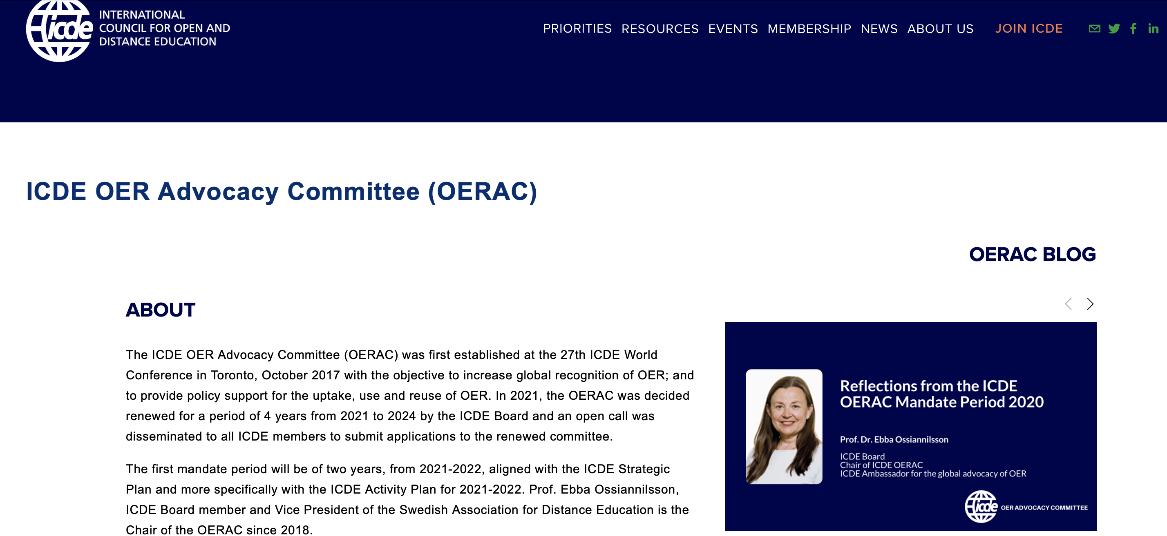

Slide 17
• Ebba Ossiannilsson, Professor, Dr. Consultant and VP, Swedish Association of Distance Education (SADE), Sweden, ICDE Board, Chair
• Jane-Frances Obiageli Agbu, Associate Professor, National Open University of Nigeria, Nigeria
• Cengiz Hakan Aydin, Professor, Anadolu University, Turkey
• Melinda de la Pena Bandalaria, Chancellor and Professor, University of the Philippines Open University, the Philippines
• Daniel Burgos, Vice-rector for International Research, Universidad Internacional de La Rioja, Spain
• Xiangyang Zhang, Emeritus Professor, Open University of Jiangsu, China
• Rosa Leonor Ulloa Cazarez, Professor, Universidad de Guadalajara, Mexico
• Mpine Makoe, Professor, University of South Africa (UNISA), South Africa
• Cristine Gusmao, Associate Professor, Federal University of Pernambuco, Brazil
• Yi Yang, Professor, Franklin University, USA
• Constance Blomgren, Associate Professor, Athabasca University, Canada
• Trish Chaplin-Cheyne, Director Learning and Teaching Development, Otago Polytechnic, New Zealand
Ambassadors

Slide 18

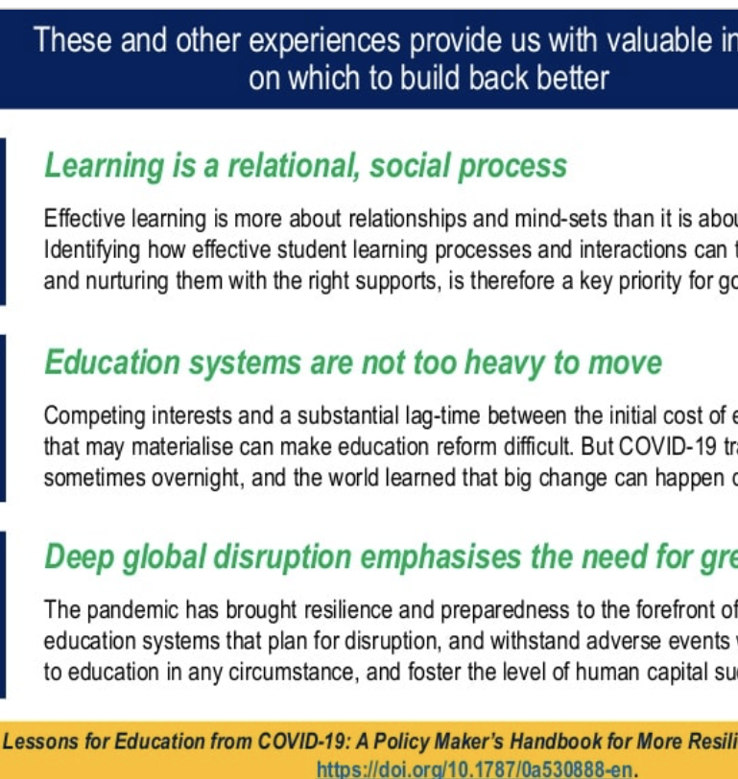
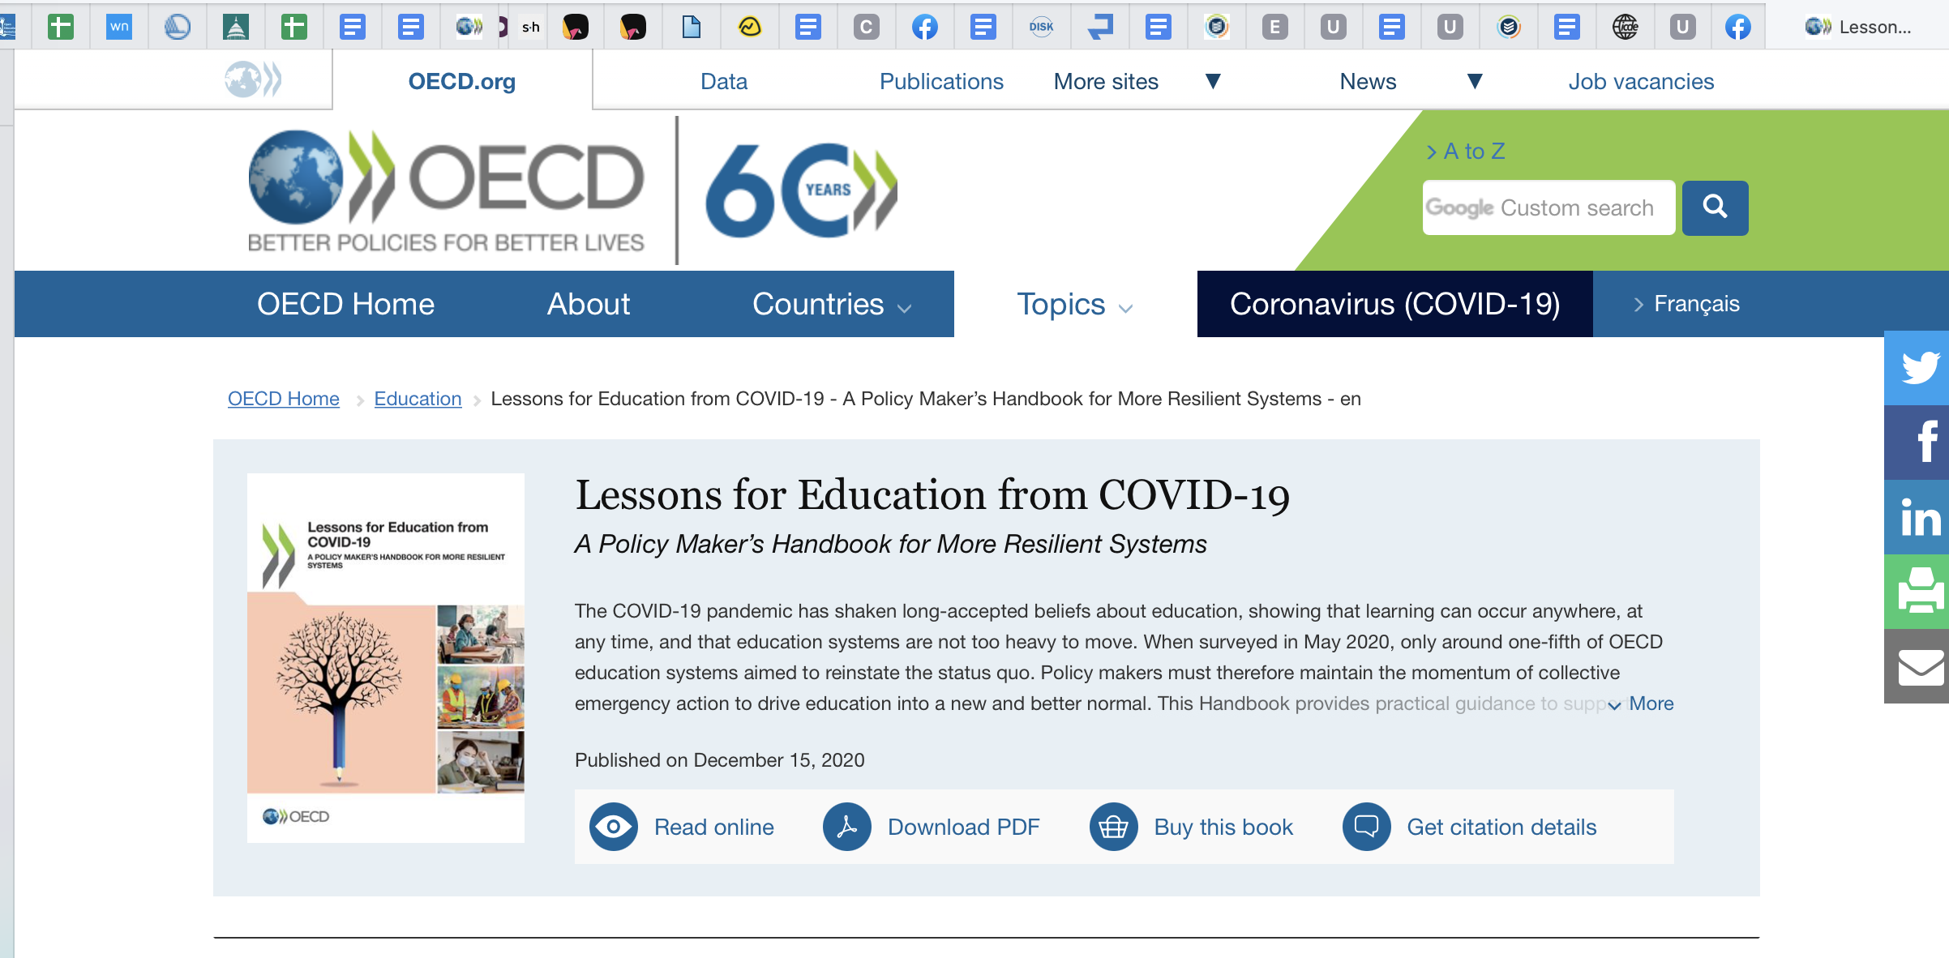

Slide 19
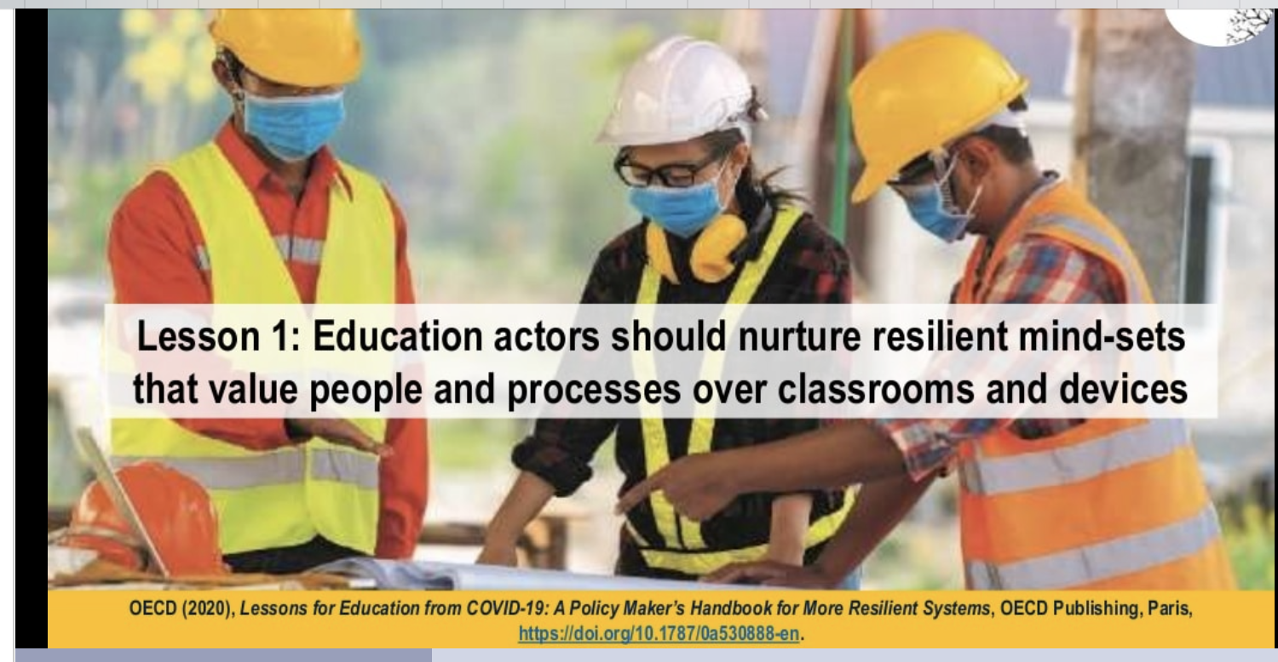
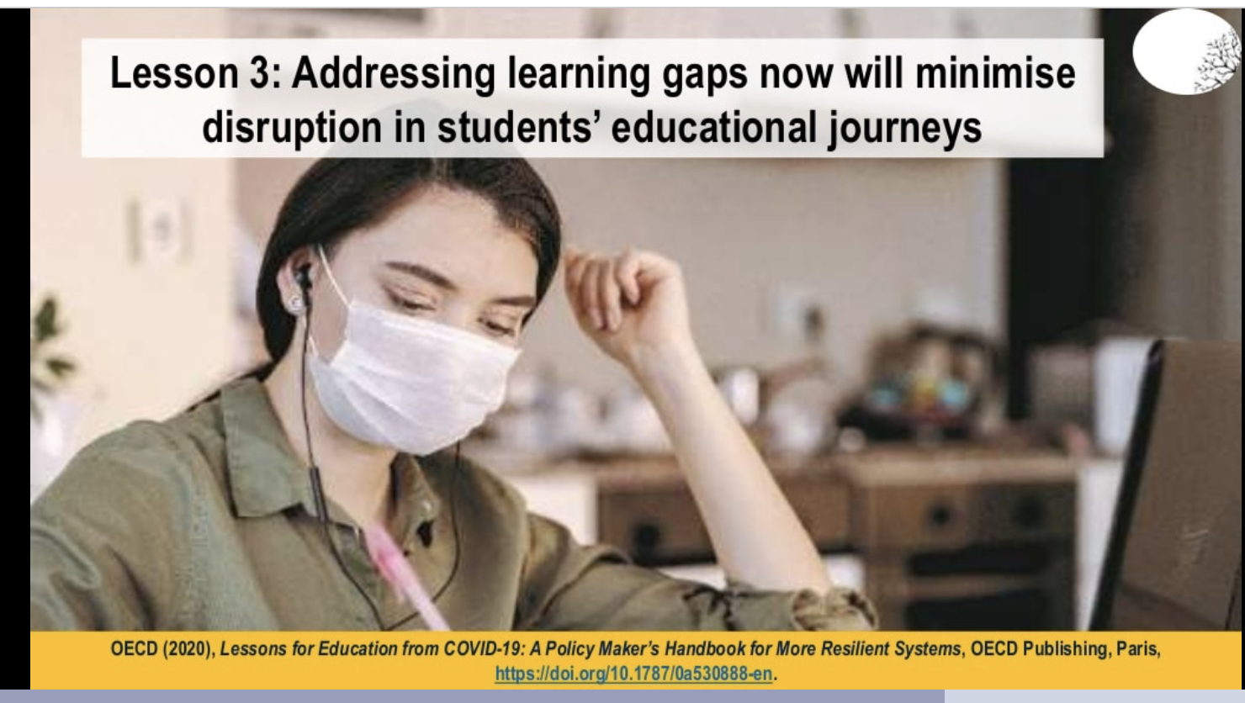
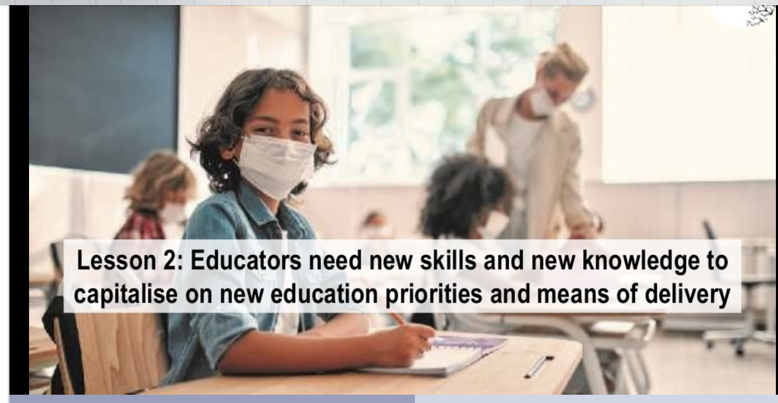

Slide 20
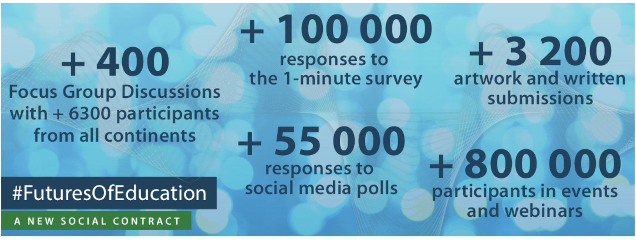
UNESCO Global Consultation

Slide 21

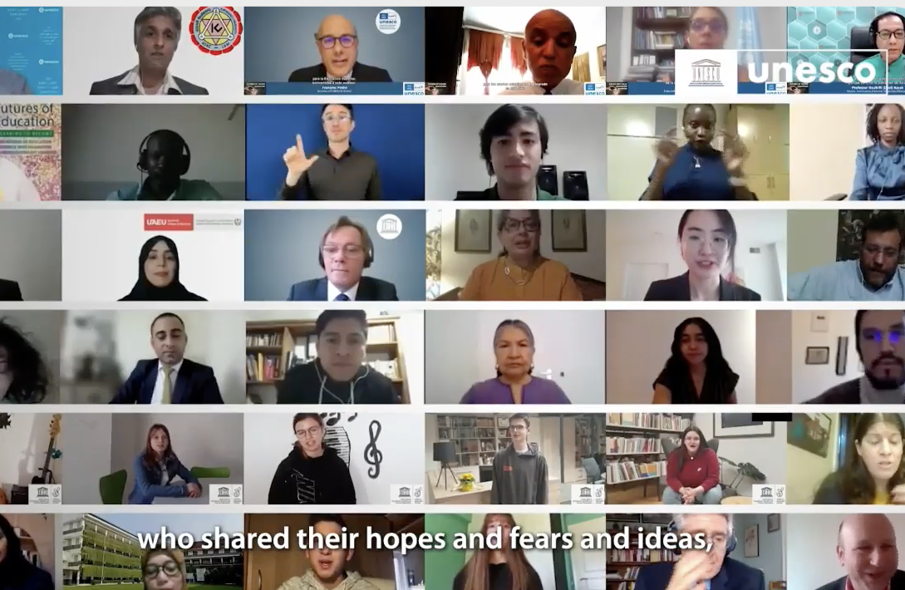
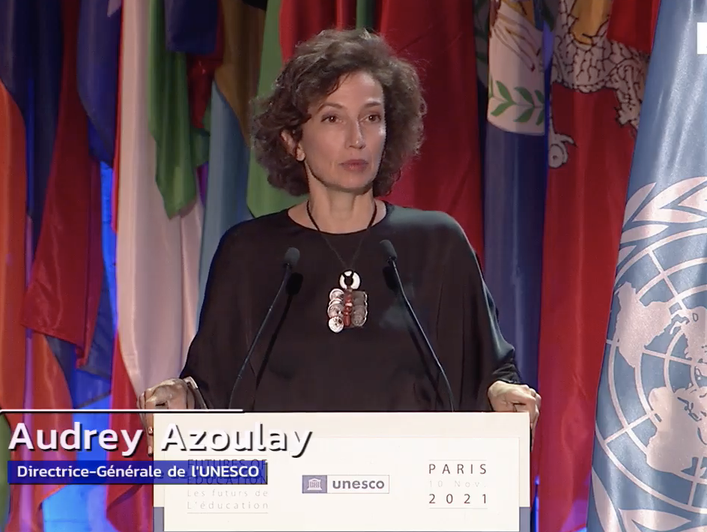
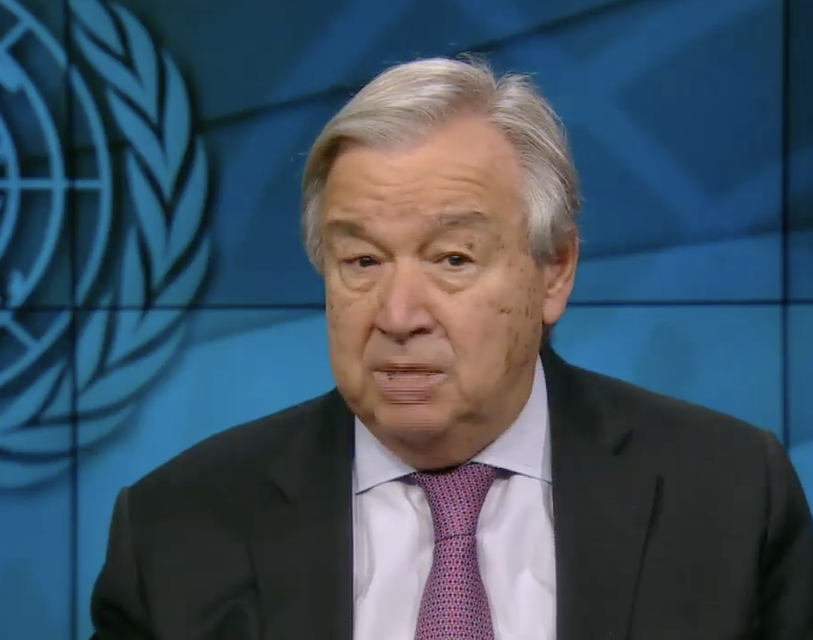
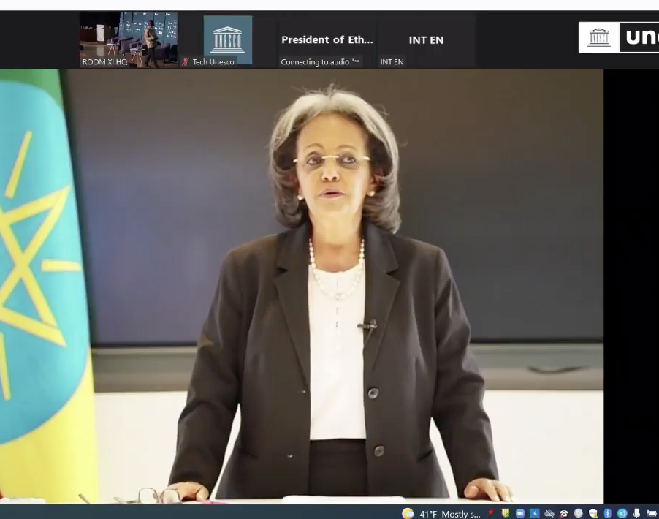

Slide 22
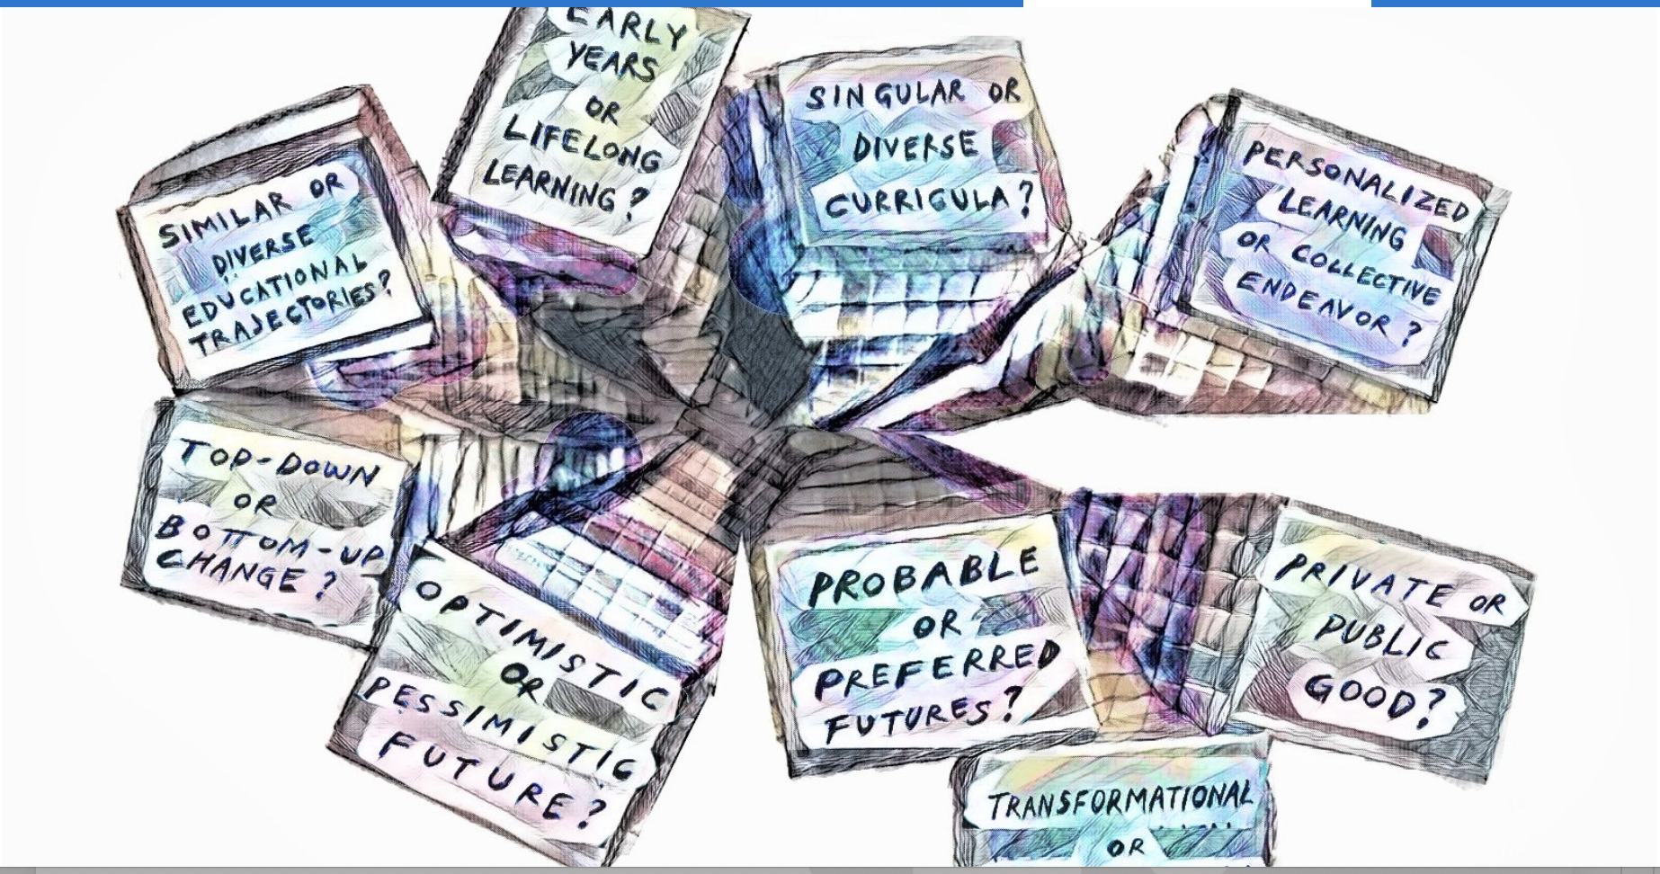
UNESCO Futures of Education: Findings

Slide 23
Nine gradients identified (1)
Public or private good
Who pays for education in the future?
Singular or diverse curricula
Which perspectives will be included in the curricula of the future?
Early learning or lifelong learning
When in life is learning most important
Personalized learning or collective endeavour
Should learning be tailored to the needs of individuals or groups?
Transformation or incremental change
Is transformational change needed for education?

Slide 24
Nine gradients identified (2)
Similar or diverse education trajectories
Will education become more or less similar across countries?
Top-down or bottom-up change
Will changes in education be top-down or bottom-up?
Optimist or pessimistic future
Are writers optimistic or pessimistic about the future of education?
Probable or preferred futures
Are writers more concerned about the future we will get
or the future we want?

Slide 25
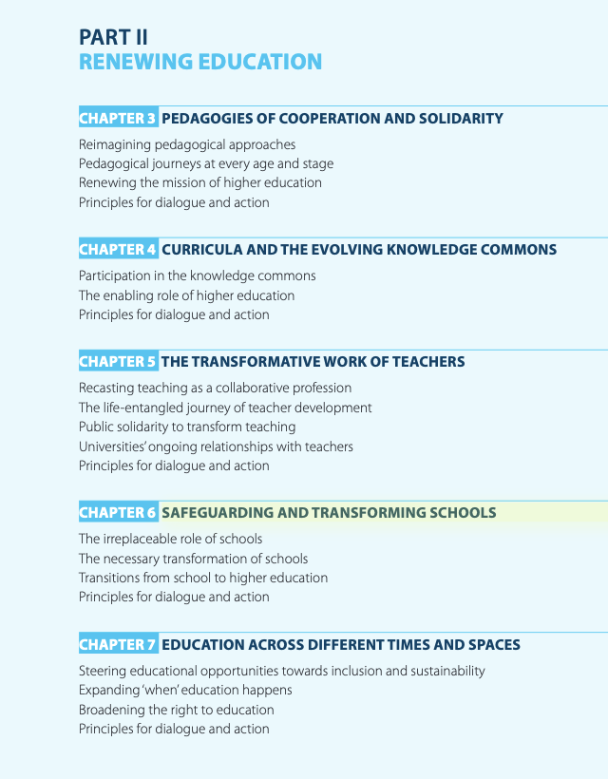
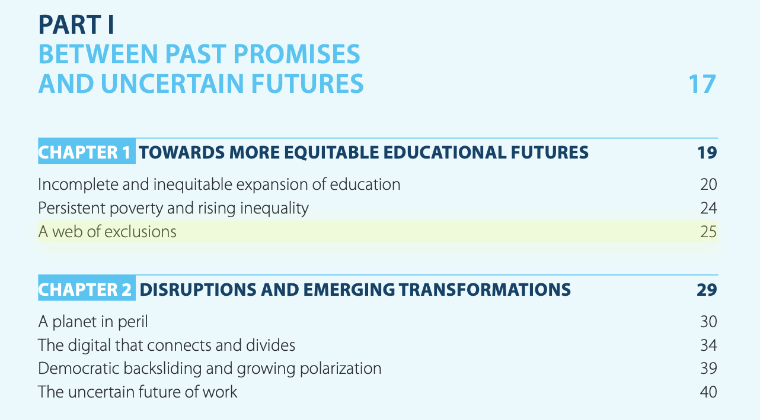

Slide 26
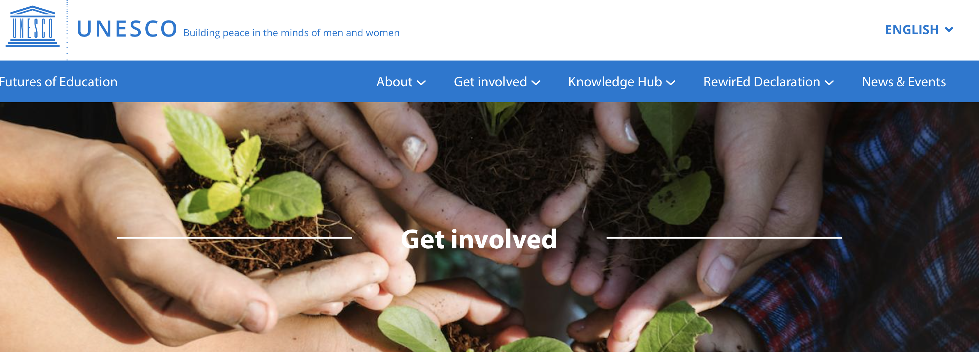
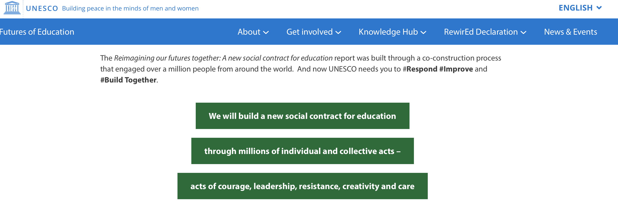

Slide 27
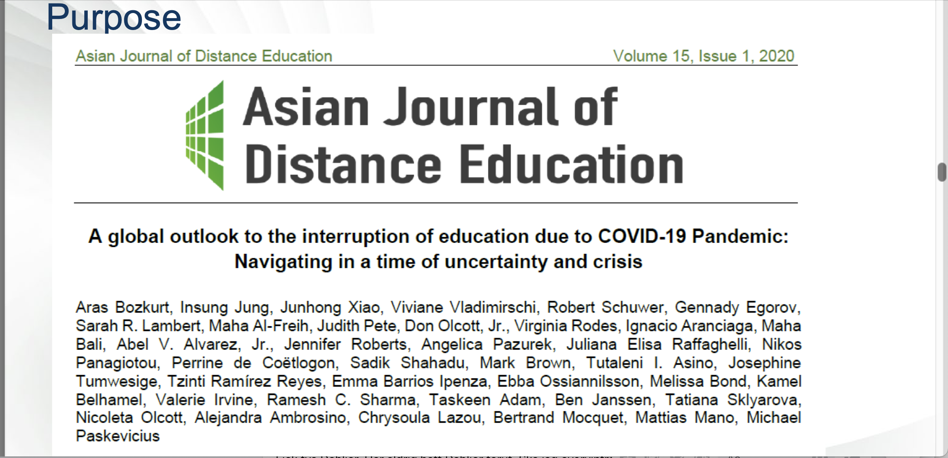
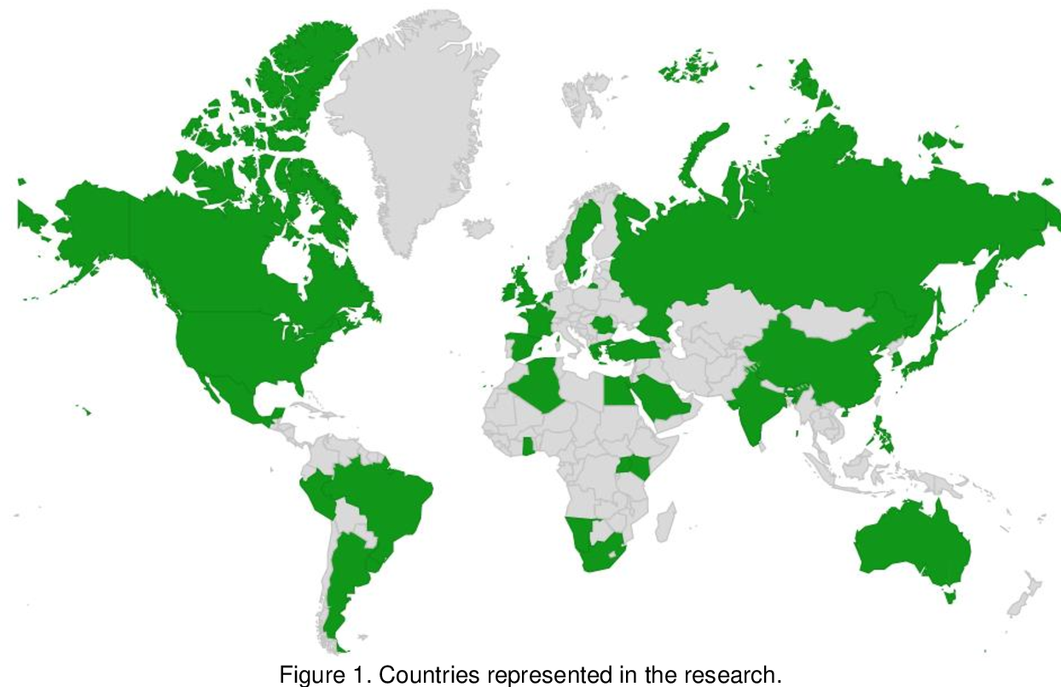
Uncertain times require prompt reflexes to survive and this study is a collaborative reflex to better understand uncertainty and navigate through it.
A case study
31 countries across the world
with a representation of 62.7% of the whole world population

Slide 28
Trauma, psychological pressure, and anxiety
Emerging educational roles of the parents and schools
Support communities and mechanisms
Pedagogy of care and trauma-informed pedagogy
Surveillance, ethics, and data privacy concerns
Digital divide
Essential (soft) skills and digital competencies
Inequity, inequality, and social justice
Openness and open education
Summary:
• Social Issues: continuing to combat inequalities during crisis
• Pedagogical challenges: adopting flexible approaches
• Harnessing technology for teaching and learning
• Psychological dimension.
Final thoughts
“...as well as creating problems in the educational landscape peculiar to Covid-19, the pandemic, in fact, exposed and surfaced already existing problems…”
Bozkurt et al. (2020). A global outlook to the interruption of education due to COVID-19 pandemic: Navigating in a time of uncertainty and crisis. Asian Journal of Distance Education, 15(1), 1-126. https://doi.org/10.5281/zenodo.3878572

Slide 29
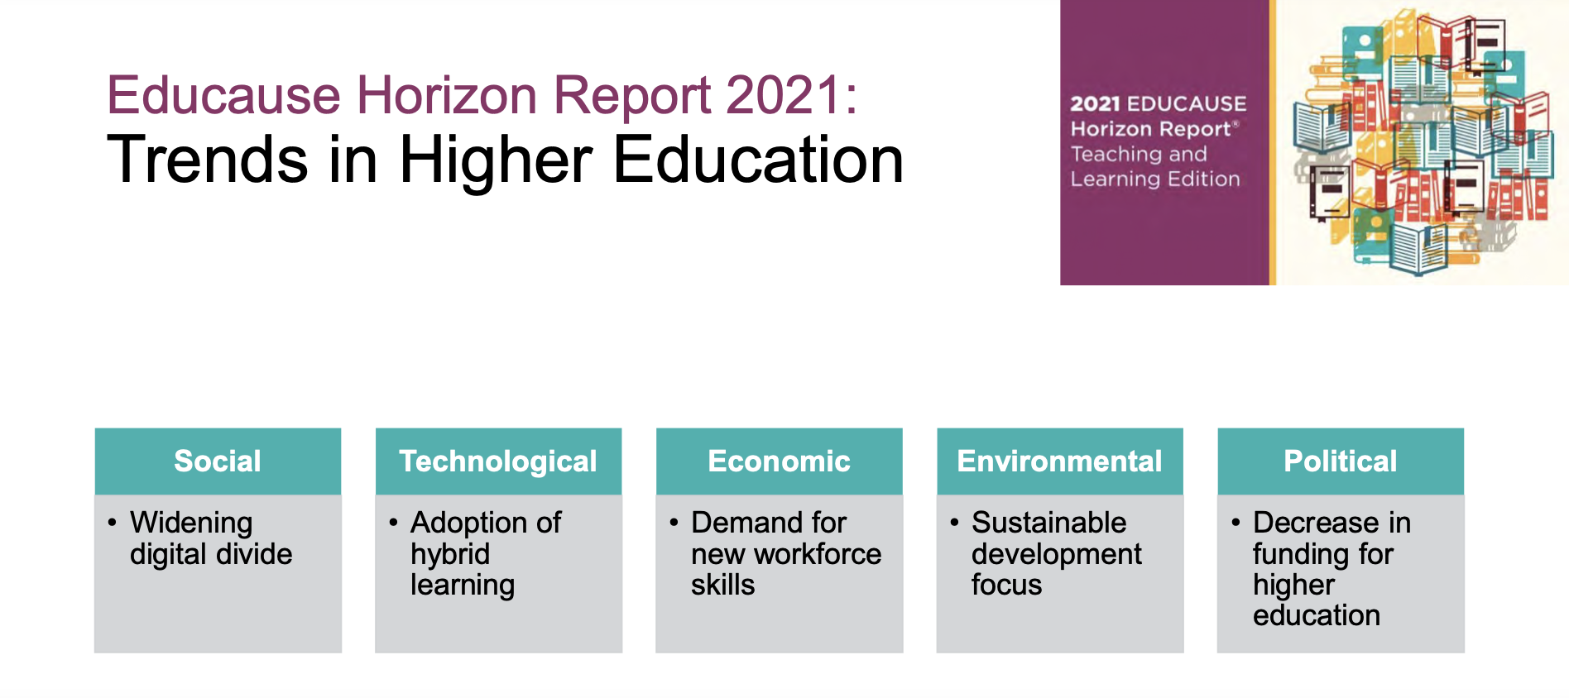

Slide 30
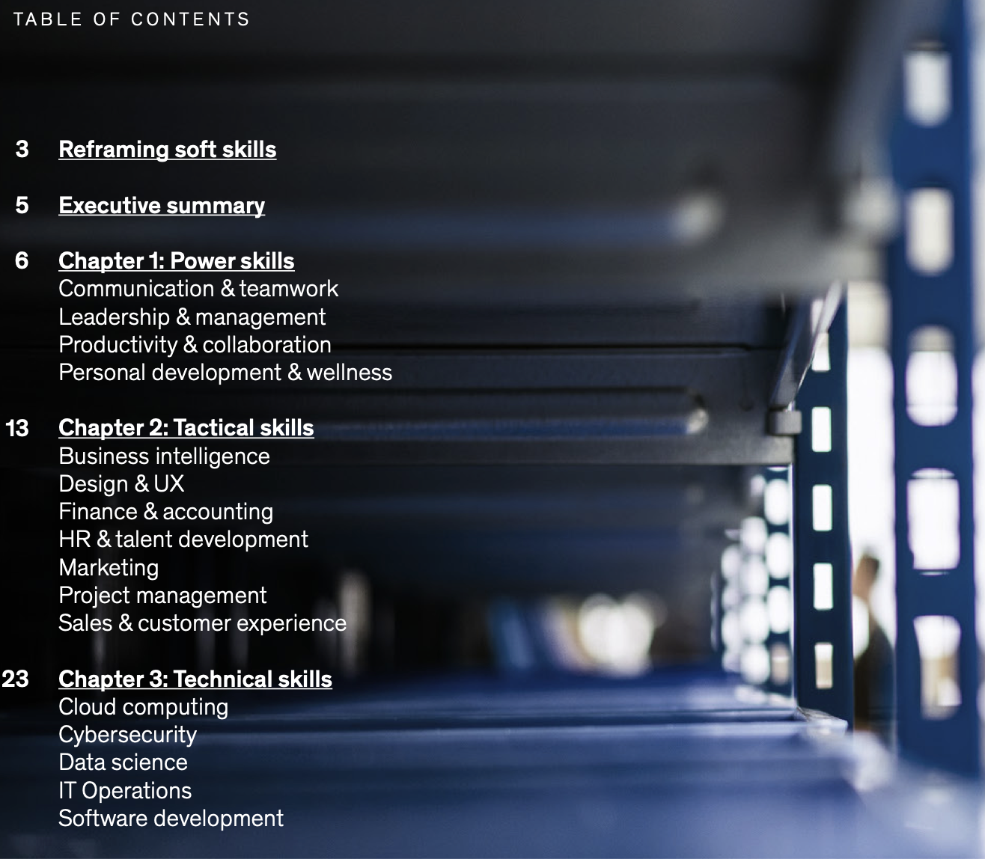


Slide 31

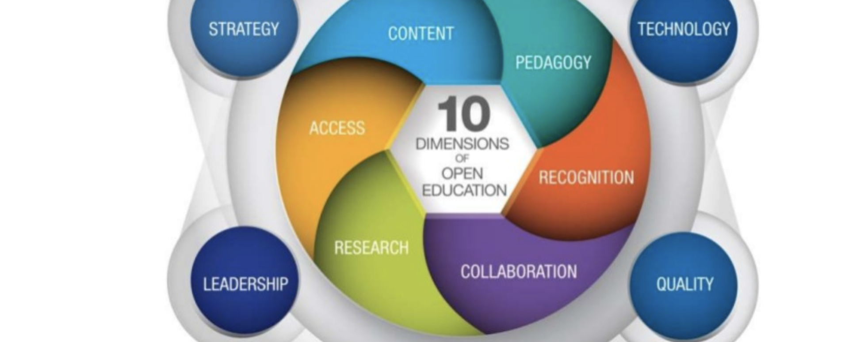

Towards a new quality agenda
Satisfaction
Engagement
Impact
Contributions to development to both individual and society growth
Wellbeing and health
Citizens for today and for the future
Innovation
Creativity
Triple Helix approach
Social justice, equity, equality, lifelong learning etc (SDG)

Slide 32
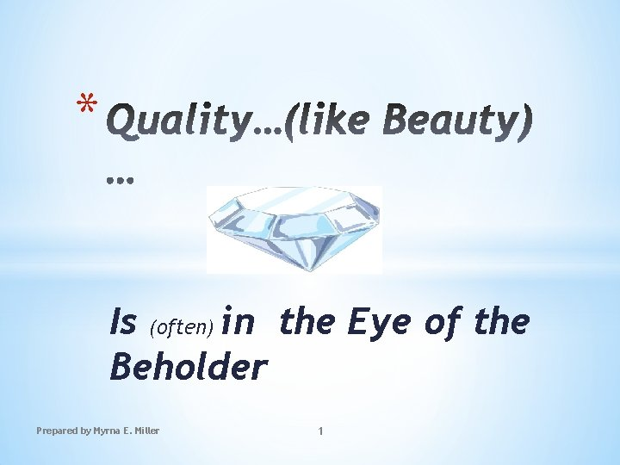

WHY
WHO
WHEN
WHAT
WHICH
LEVELS
HOW
ECOSYSTEM

Slide 33
Nine gradients identified
Public or private good
Who pays for education in the future?
Singular or diverse curricula
Which perspectives will be included in the curricula of the future?
Early learning or lifelong learning
When in life is learning most important
Personalized learning or collective endeavour
Should learning be tailored to the needs of individuals or groups?
Transformation or incremental change
Is transformational change needed for education?
Similar or diverse education trajectories
Will education become more or less similar across countries?
Top-down or bottom-up change
Will changes in education be top-down or bottom-up?
Optimist or pessimistic future
Are writers optimistic or pessimistic about the future of education?
Probable or preferred futures
Are writers more concerned about the future we will get
or the future we want?

Slide 34
My Footprints
www.i4quality.se
Ebba.Ossiannilsson@gmail.com
info@i4quality.se
OERAC LINKEDIN
CARING IS SHARING, SHARING IS CARING
THANK YOU!

Slide 35

UNESCO: Futures of Education

Slide 36
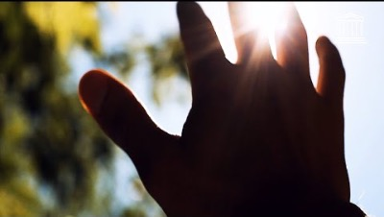

Slide 38
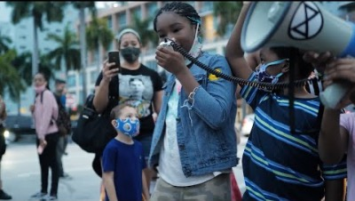
UNESCO: On the Social Contract

Slide 39



Slide 40
WHAT IS SOCIAL-EMOTIONAL LEARNING?
…. “the process through which children and adults acquire and effectively apply the knowledge, attitudes, and skills necessary to understand and manage emotions, set and achieve positive goals, feel and show empathy for others, establish and maintain positive relationships, and make responsible decisions.”
Collaborative for Academic, Social, and Emotional Learning(CASEL)

